Slide 1

CONTENTS
Our project is a person tracking system with face detection.
Introduction
Our project could be used in a place which can be dangerous to stay more than a certain time.
ESP32 Cam Module - Prolific PL2303 USB-TTL Serial Converter Cable - Prolific PL2303 USB - TTL Serial Converter - BoardJumper(F/M -200mm) - Breadboard - 16 GB SD Card - PL2303 USB UART Board
Project Design
Ardunio IDE - C++ - Computer Vision Library - Opencv
Conclusion
Connecting the camera and the Esp32 and running libraries and code on card.
We introduced the person to esp32 with the camera. We calculated the duration of the person's stay inside and gave a warning when the timeout occurred.

Slide 2

PERSON TRACKING SYSTEM WITH ESP32
Semester II (2021-2022)
Embedded Systems Course
Final Project Presentation
Course Code: CPE316
Supervisors: Dr. Iman Elawady ; ENG. Michael B.Khani
Team PHOENIX members:
Esmanur ALICAN 1810215066 esmnralicann@gmail.com | Fehmi GUNAY 1810205040 gunay.fehmi14@gmail.com
Yasemin EKER 2107010206002 yasemineker06@hotmail.com | Ebru KIRIKKAYIŞ 1810205089 ebrukirikkayis@gmail.com
Irem KARAAYTU 1810205057 iremkryt@yaani.com | Berk Ali MERAL 1810205030 berkalisimsek@hotmail.com
Alperen SARIERIKLI 1810205052 alperensarierikli@hotmail.com | Bilal BERISPAK 1810205032 bilalberispak@gmail.com
Team leader is Esmanur ALICAN

Slide 3

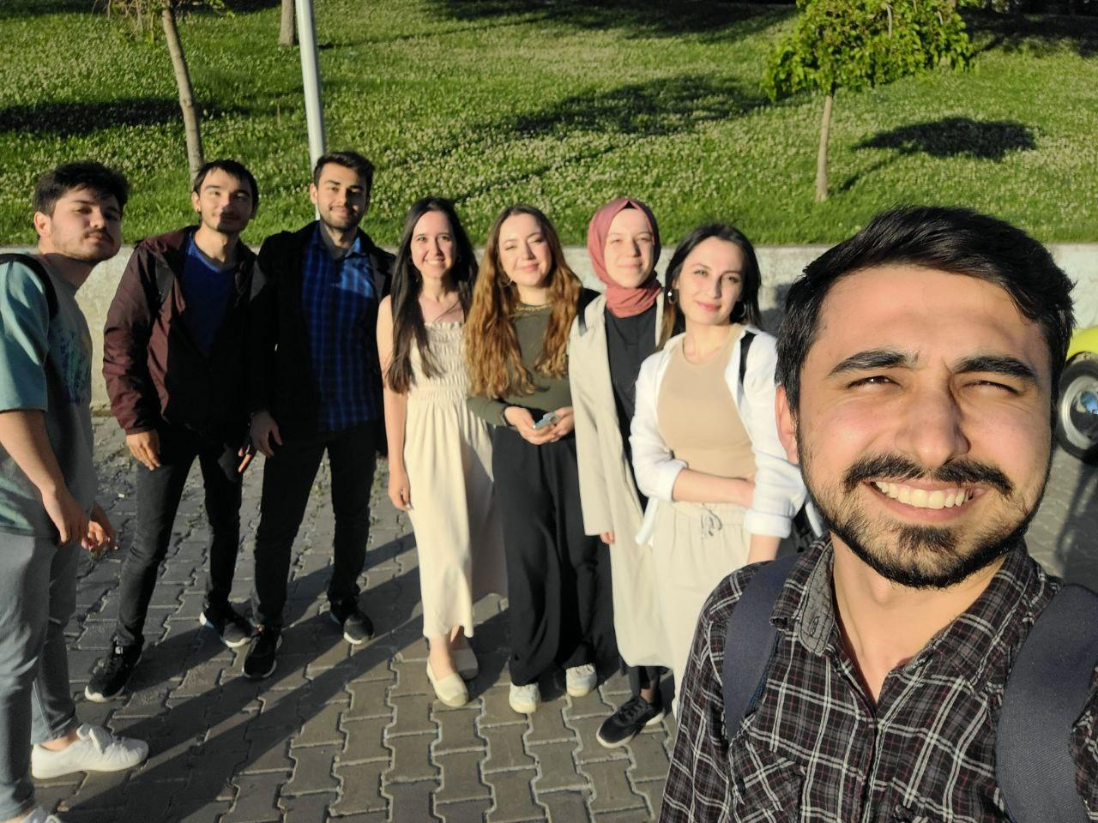
INTRODUCTION

Slide 4
INTRODUCTION
We developed the facial recognition and person tracking system using ESP32 Cam and Arduino IDE.
When this system introduces the person's face to the camera, if the person's face is registered in the database, the entry is confirmed by the system and the led lights up, then the counter is started.
At the end of the specified time, the LED turns off and the buzzer starts to make a sound to introduce the person's face again. The person introduces his/her face again and the process ends.

Slide 5
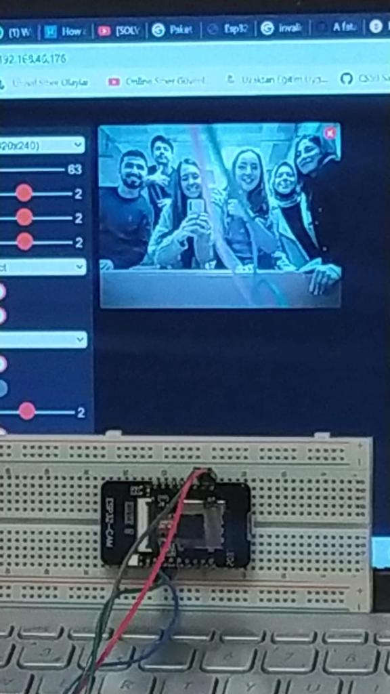
INTRODUCTION
Goals
This project aims security with tracking the time that a person has spent in a room.
Our project could be used in a place which can be dangerous to stay more than a certain time. For example, a chemistry lab. If a scientist spends a lot of time in the lab more than 5 minutes, the buzzer makes sound and the LED lights up.

Slide 6

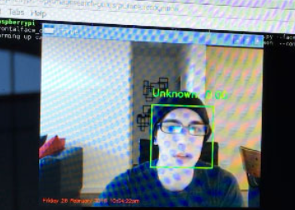
RELATED WORKS
In this project, facial recognition will be performed on Raspberry Pi and a simple security system will be created that can send us text message alerts when intruders enter the video stream.
To realize this project will be used:
Knowledge (and applications) from PyImageSearch Gurus modules on facial recognition.
Amazon Simple Storage Service (S3) for uploading images of intruders to the cloud.
Twilio API to capture uploaded photos and automatically send them to our smartphone instantly alerts us when intruders enter a sandbox.
Goals:
Leveraging our facial recognition knowledge and applying it to Raspberry Pi.
Determining if an intruder has entered the view of the Raspberry Pi camera, and if so:
Uploading a photo of the intruder to Amazon S3.
Instant sending of a photo of the intruder to our smartphone.

Slide 7

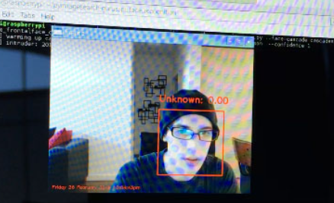
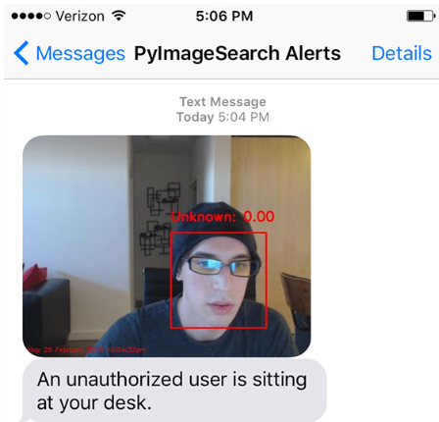
RELATED WORKS
Summary
To guard against false positive detections, ensured that the "intruder" was marked "Unknown" for a sufficient number of frames before sending this text message. When implementing code that requires processing a video stream and deriving information from frames, it is good practice to ensure that an event, event, or identification occurs for a predetermined number of frames before sending an alert or taking any other action.

Slide 8
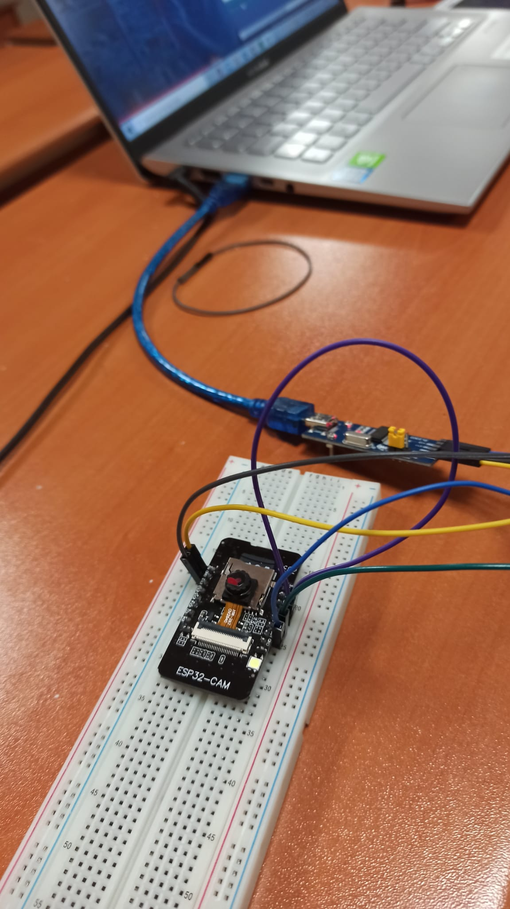
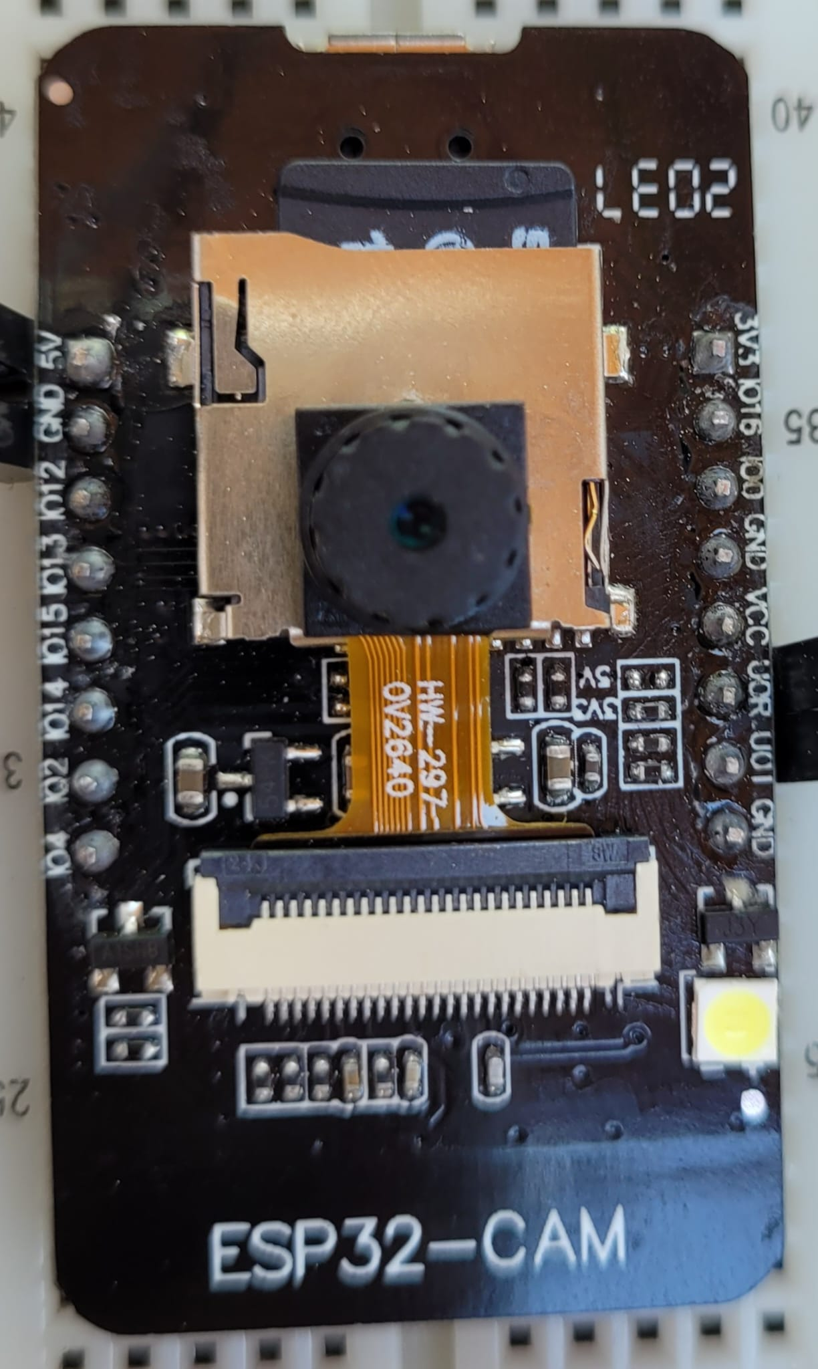
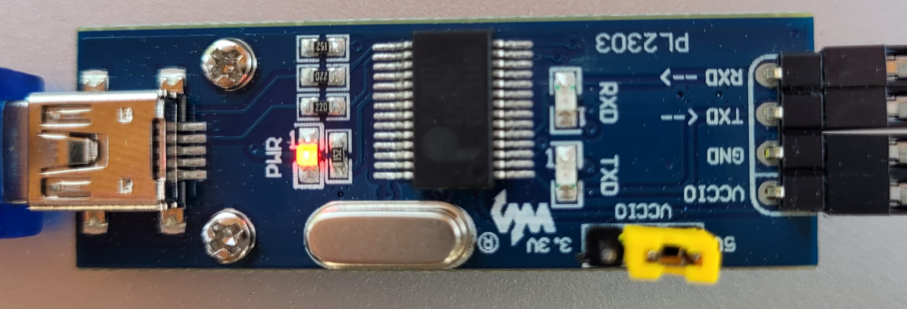
PROJECT DESIGN
ESP32 CAM MODULE
Prolific PL2303 USB - TTL Serial Converter
ESP32, like Arduino, is a development board.
Prolific PL2303 is a USB-to-Serial adapter cable that lets you connect your computer to the devices with serial ports.

Slide 9
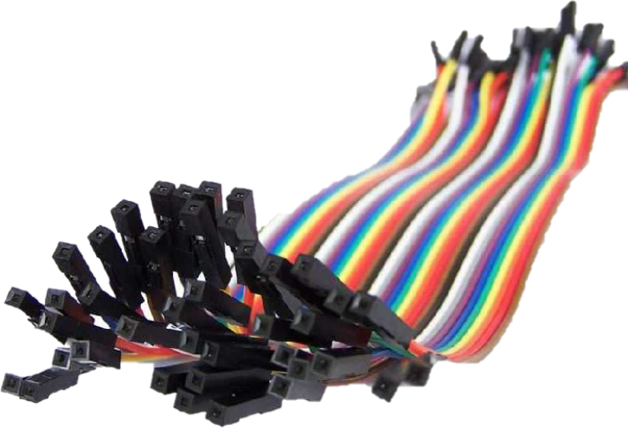
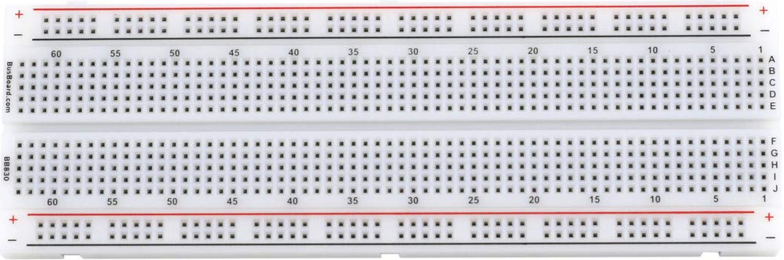
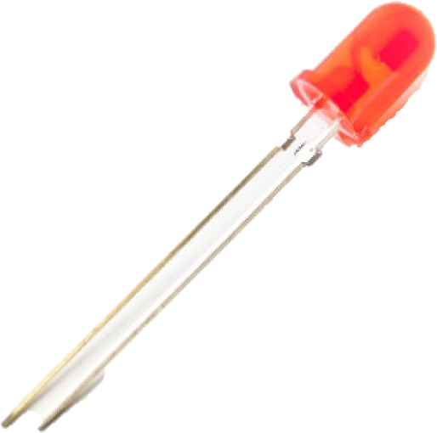
PROJECT DESIGN

Slide 10
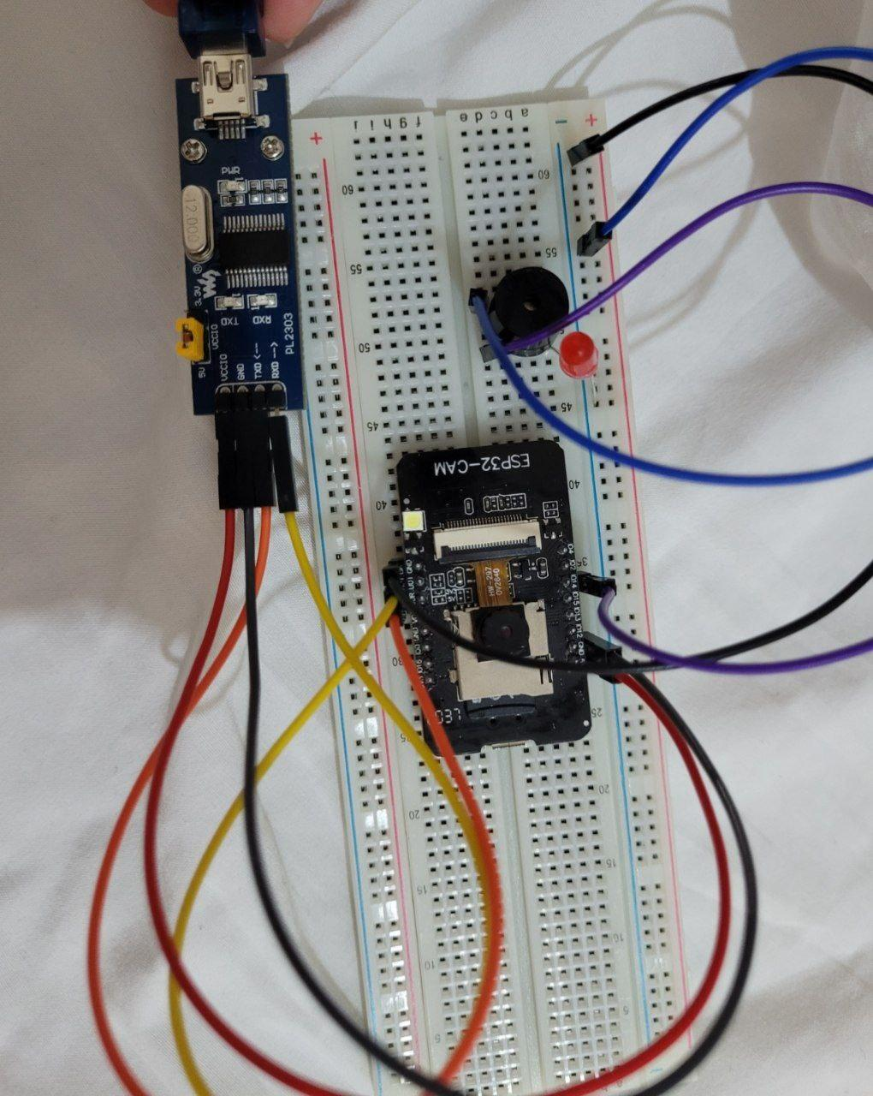
PROJECT DESIGN

Slide 11
PROJECT DESIGN
Hardware Limits: ESP32 is good for basic applications like just for video streaming but it's not good enough for face recognition or detection. The camera fps is very low when face detection or recognition is on.
Software limits: We used C++ for our project and it is harder compared to Python. It would be better if we could use Python but Ardunio doesn’t support Python.
Another software limit is that we couldn’t use database or we couldn’t use Machine Learning Algorithms or create a new dataset for face detection because ESP32 is not capable of these.

Slide 12
CONCLUSION

Slide 13
CONCLUSION
This project’s main goal is to provide life safety. To achieve that, we detect the persons face with ESP32 Cam, then start the timer. After 5 minutes the buzzer starts to make alert noise and sends alert message to authorized department. To make buzzer stop, the person should show their face to the camera and leave the place. When the face detected correctly, the buzzer and timer resets and everything is fine.
We can’t figure out how to send alert message to authorized department so couldn’t do that part but this project does all the remaining parts.
This project provides safe entry to dangerous places and helps to prevent any harm that could happen there.

Slide 14

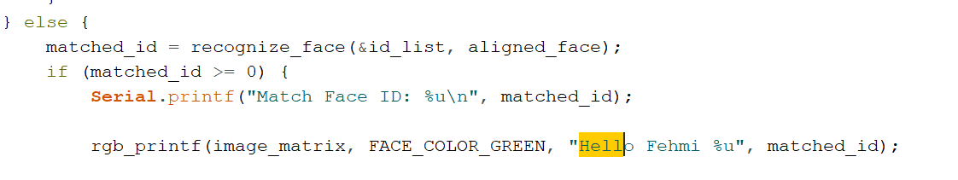
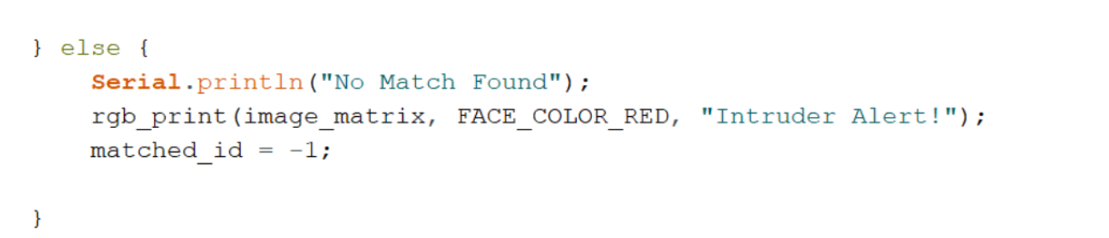
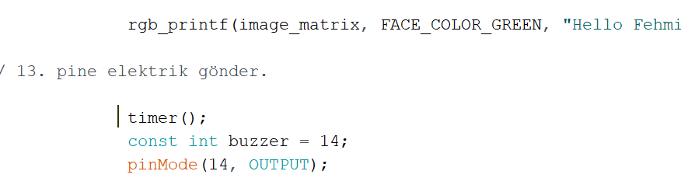
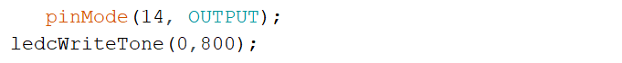
The piece of code where facial recognition is done.
Warning when the introduced face is not found in the system.
When the person does not recognized by the system buzzer will sound on.
The code for turn on the led.

Slide 15
REFERENCES
https://www.robotistan.com/
https://towardsdatascience.com/everything-you-ever-wanted-to-know-about-computer-vision-heres-a-look-why-it-s-so-awesome-e8a58dfb641e
https://opencv.org/
https://customers.pyimagesearch.com/lesson-sample-face-recognition-for-security/

Slide 16


THANK YOU
FOR
LISTENING

